Slide 1
Financial Fraud Detection Using Machine Learning Techniques
By - Harpreet Shoker

Slide 2
Introduction
Digital payments of various forms are rapidly increasing across the world. Payments companies are experiencing rapid growth in their transactions volume.Preventing online financial fraud is a vital part of the work done by cybersecurity and cyber-crime teams.Therefore, it is essential to explore the approach to solving the problem of detecting fraudulent entries/transactions in large amounts of data in order to be better prepared to solve cyber-crime cases.

Slide 3
Aims and Objectives
Study and understand different aspects of financial fraud.
Solve the problem of financial fraud detection on a publicly available sample dataset using supervised machine learning techniques
Compare different classification techniques to understand which is best suitable for this application.

Slide 4
Limitations of the study
We used a pre-labeled dataset to train the algorithms. However, usually, it is difficult to find labelled data and thus applying supervised machine learning techniques may not be feasible. In such cases, we should evaluate unsupervised techniques which were beyond the scope of this study.
These variables that helped in detecting fraud may not apply to types of financial transactions, such as credit card fraud. We evaluated 3 machine learning algorithms – Logistic Regression,Random Forest and XGBoost. Although the result of the study using these algorithms is good, it is necessary to evaluate other techniques to determine which algorithm works best for this application.
Due to the large size of data, we were limited by computation capacity to explore different techniques such as grid search for parameter tuning,

Slide 5
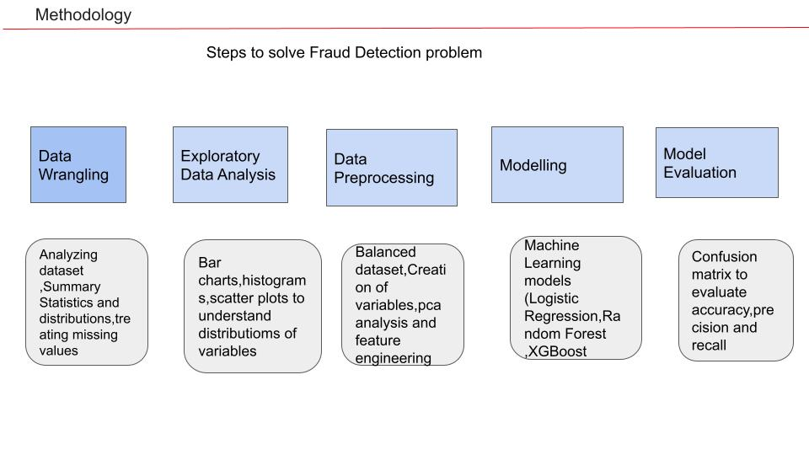
Methodology

Slide 6
Data Source
A synthetic dataset that is publicly available on Kaggle, generated using a simulator called PaySim is used. The dataset was generated using aggregated metrics from the private dataset of a multinational mobile financial services company, and then malicious entries were injected.The dataset contains 11 columns of information for ~6 million rows of data. The key columns available are
Type of transactions
Amount transacted
Customer ID and Recipient ID
Old and New balance of Customer and Recipient
Time step of the transaction
Whether the transaction was fraudulent or not

Slide 7
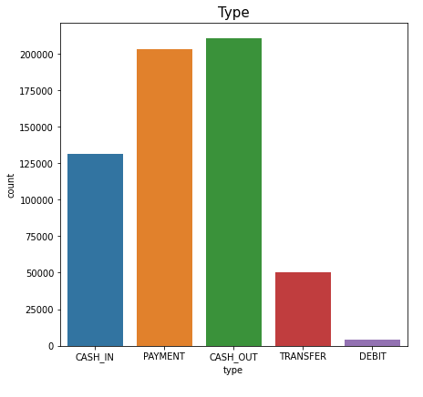
Types of Transactions
The plot shows the frequencies of different types of transactions in the dataset

Slide 8
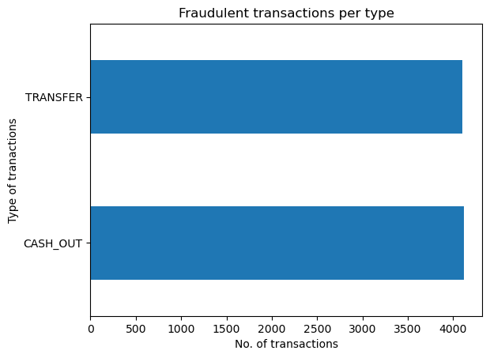
Fraud transactions are only occurring for Transfer an Cash Out types of transactions.

Slide 9
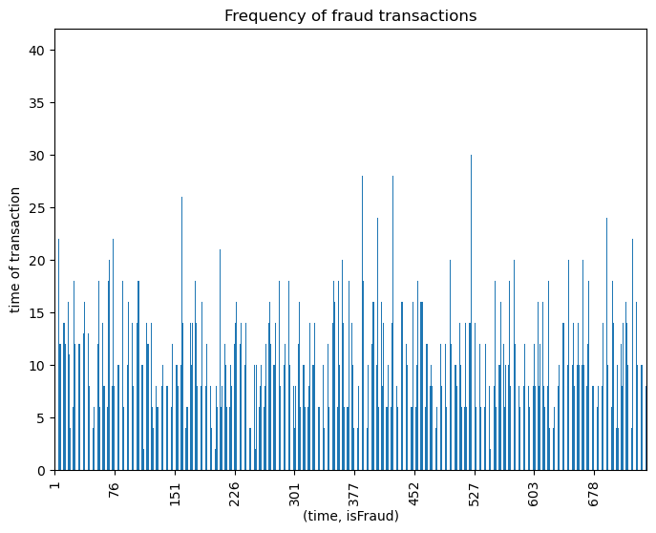
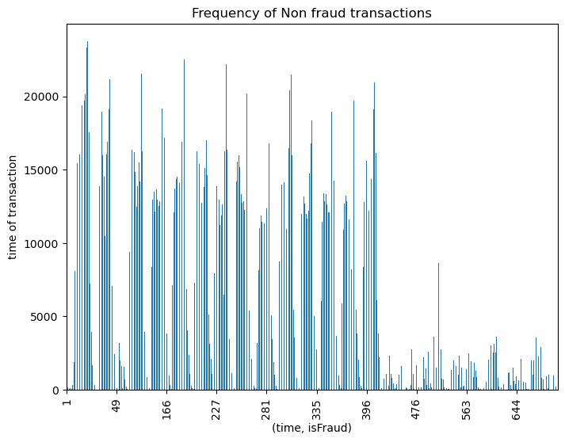
Fraud Transaction Analysis
Time Step Feature
The number of transactions in each time step by fraud status was measured in order to identify if there are any particular time steps where fraudulent transactions are more common than others. From the above figures the fraud transactions are almost uniformly spread out across time steps, whereas non-fraudulent transactions are more concentrated in specific time steps.

Slide 10
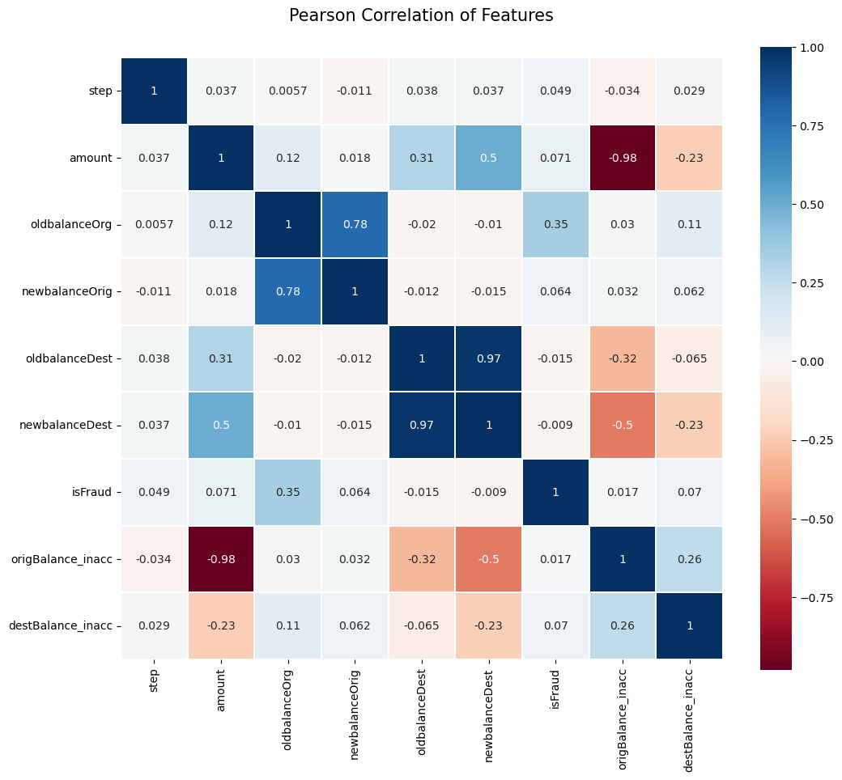
Correlation Plot of variables against target variable
Input features oldbalanceDest and newbalanceDest are correlated with each other similarly oldbalanceOrig and newbalanceOrig are also correlated with each other. To decide which one to drop amongst them we have to check their correlation with dependent feature (isFraud), oldbalanceDest is highly negatively correlated (-0.0059) with target feature than newbalanceDest (0.00054).Dropping oldbalanceOrg and newbalanceDest feature.

Slide 11
Data Preprocessing and Training data
Standardization is used when features of the input data set have large differences between their ranges.Differences in features amount and oldbalance and newbalance columns can impact the model performance so we standardized these variables using StandardScaler().
Label Encoding is used to convert categorical features to numeric form to make them machine readable.For the categorical variables in our data set we used one hot encoding for the 'type' feature and we used label encoder for the namesorg and namedest.

Slide 12
Classification Models for Fraud Detection
We define 3 models to perform the classification: Logistic Regression,Random Forest and XGBoost.To measure the performance of the models we need to use
Recall is a useful metric. High-class imbalance datasets typically result in poor Recall, although accuracy may be high.
Precision will also be a consideration because reduced precision implies that the company that is trying to detect fraud will incur more cost in screening the transactions. In fraud detection problems, though, accurately identifying fraudulent transactions is more critical than incorrectly classifying legitimate transactions as fraudulent.
We will use Area Under Curve (AUC) of the ROC curve. However, this will not adequately capture if the model is correctly identifying most of the fraudulent transactions. Therefore, we use this as a validation of the model performance.
We also need to do cross-validation to ensure the models do not overfit the training data. For this, we use Stratified 5-fold since we need to ensure that the class imbalance is retained in the validation sets.

Slide 13
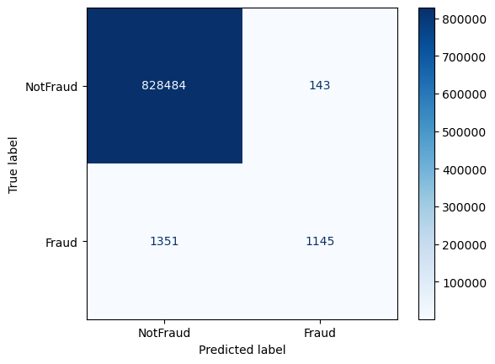
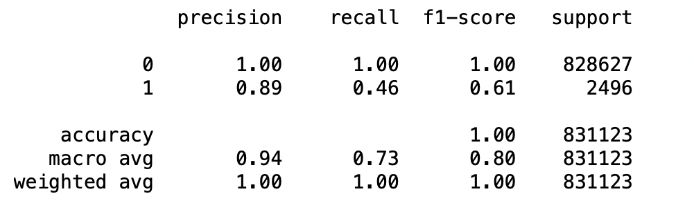
Logistic Regression Model
We train the logistic regression model and calculate the mean recall score. This parameter we are considering as base model.
The following output indicates how the Logistic Regression model performs on the training dataset.
Need to improve Precision,Recall and F1 Scores.

Slide 14
Addressing Class Imbalance
We use undersampling as it is less computation-intensive. We also do this for all our models.We retain all the fraud cases and randomly select an equal number of non-fraud cases to create an undersampled training dataset.There are many techniques to address high-class imbalanced datasets. A few examples are as follows
Undersampling: In this method, random samples from the majority class are deleted so that the class imbalance is more manageable.
Oversampling: In this method, observations of the minority class are resampled with repetition to increase their presence in the data
SMOTE: This is a type of oversampling, but instead of repeating the observations, it synthesizes new plausible observations of the minority class

Slide 15
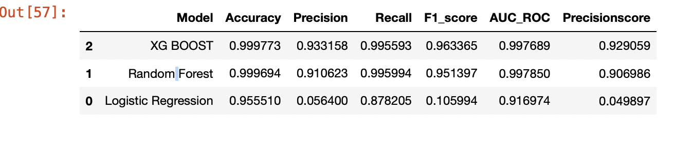
Best Fit Model
We tried all three models after undersampling the data. Random forest and XGBoost results were better than Logistic Regression.So we performed hyper parameter tuning and cross validation on both the later models.We saw the XGboost is performing the best.

Slide 16
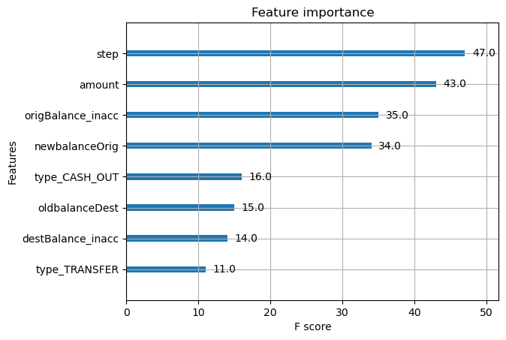
In the following figure, we present the relative feature importance of the XGboost model. The fig. shows which variables are contributing more to fraud prediction.

Slide 17
Conclusion
We successfully developed a framework for detecting fraudulent transactions in financial data. This framework will help understand the nuances of fraud detection such as the creation of derived variables that may help separate the classes, addressing class imbalance and choosing the right machine learning algorithm.
We experimented with 3 machine learning algorithms – Logistic Regression,Random Forest and XGBoost. The XGboost algorithm gave results closer to Random forest but far better results than Logistic Regression indicating tree-based algorithms work well for transactions data with well- differentiated classes
..

Slide 18
References
E. Ngai et.al., The Application of Data Mining Techniques in Financial Fraud Detection: A Classification Framework and an Academic Review of Literature, Decision Support Systems. 50, 2011, 559–569
Albashrawi et.al., Detecting Financial Fraud Using Data Mining Techniques: A Decade Review from 2004 to 2015, Journal of Data Science 14(2016), 553-570
TESTIMON @ NTNU, Synthetic Financial Datasets for Fraud Detection, Kaggle, retrieved from https://www.kaggle.com/ntnu-testimon/paysim1

Slide 19
THANK YOU

